Slide 1
American Indian and Minority Achievement in the Montana University System
Angela McLean, Director American Indian/Minority Achievement & K-12 Partnerships
Travis Anderson, Ed.D., Director Montana GEAR UP
March 25, 2021

Slide 2
AIMA Council Membership
2020-2021
Voyd St. Pierre, Superintendent- Rocky Boy Schools
Shawn Hendrickson, St. Ignatius Public Schools
Emily Williamson, Financial Aid Director, University of Montana
Dr. Kate Shanley, Native American Studies, University of Montana
Joe McGeshik, Director American Indian Achievement Center, Montana State Billings
Dr. Margarett Campbell, Director of American Indian Education, Montana State University Northern
Katherine Meier, Director of Disability Services & Native American Enrichment Center, Great Falls College
Michelle Guzman, Director American Indian Student Success Center, University of Montana
Ilene Cohen, Director of Student Success and TRIO SSS, University of Montana Western
Corey Sangrey, President, Stone Child College
Mike Jetty, Indian Education Specialist, Montana Office of Public Instruction
Ariel Donohue, Senior Diversity Officer, Montana State University
Dr. Walter Fleming, Native American Studies, Montana State University
Amy Verlanic, Executive Director Education Opportunities Center, Montana Tech
Amber Paulson, Learning Center Director, Flathead Valley Community College
Dr. Nathan Lindsay, Vice Provost for Academic Affairs, University of Montana
Kimberley Hayworth, Student Affairs, Montana State University Billings
Dan Durglo, Vice President Academic Affairs, Salish Kootenai College

Slide 3
AIMA Council Recommendations

Slide 4
Identify an individual at each campus who is at a more senior level who will serve point of contact for American Indian students. This person will work with college/university leadership to advise retention and completion strategies for American Indian students. The individual will also be available as a first point of contact to guide American Indian students to the appropriate college personnel as needed to address problems or specific needs.
2) Assign departmental points of contact who have the unique “cultural perspective” to serve American Indian students most effectively in the areas of (these efforts will be coordinated by the individual identified in recommendation #1): a. Financial Aid b. Residence Life and Housing c. Admissions d. Students Health and Counseling e. Registrar f. Human Resources g. Advising
3) Collect and share basic data on American Indian students relative to improving the use of data and information to investigate American Indian enrollment and student success.
4) Provide a common American Indian cultural and sensitivity professional development for all faculty and staff.
5) Request campuses to incorporate American Indian professional development referenced in recommendation #4 in all new employee orientation including faculty.

Slide 5
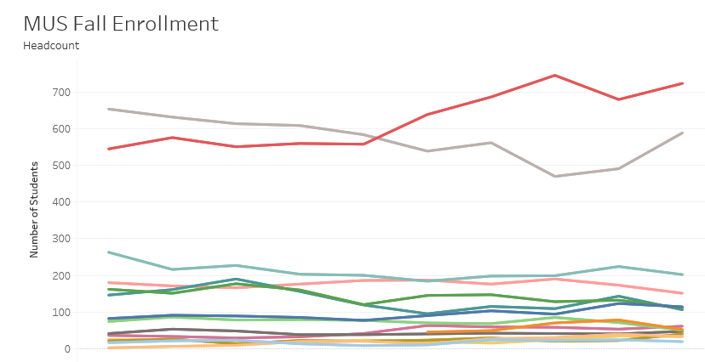
American Indian Student Enrollment
American Indian Enrollment now at 5.8% of MUS student enrollment
2018-19 at 5.5%

Slide 6
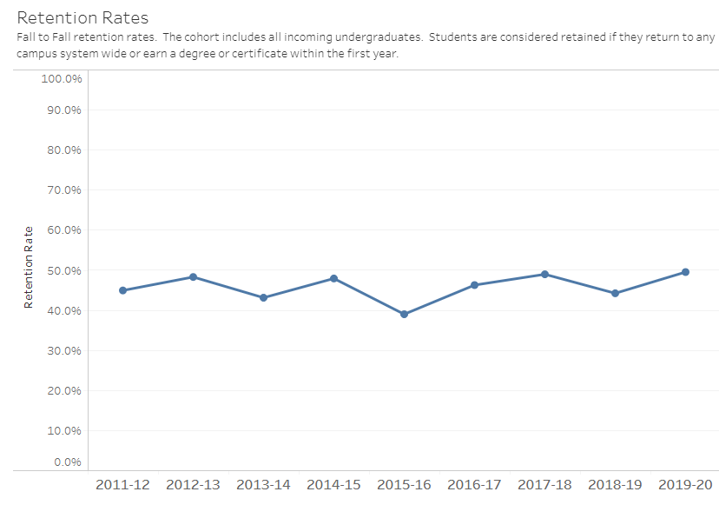
MUS Campus Retention
Slight increase in overall retention rates from last year from 53.1% to 54.9%
Flagship Retention increased from 60.8% (2019) to 63.4.% (2020)
Two Year Campus Retention increased from 44.2% in 2019 to 49.5% in 2020

Slide 7
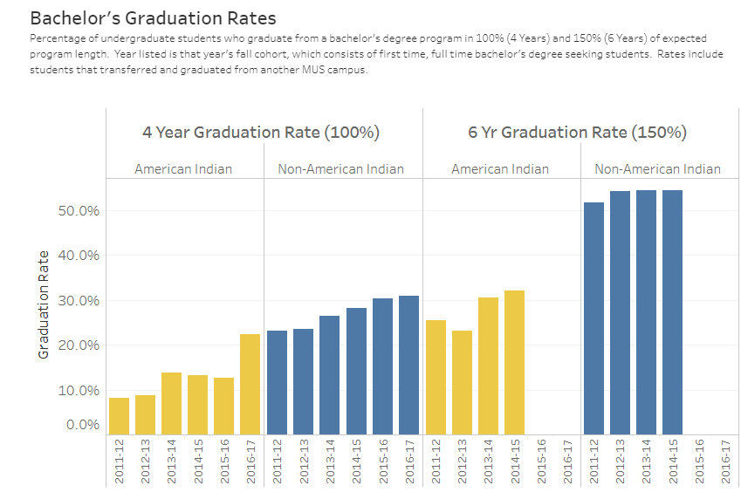
Bachelor’s Graduation Rates
4 and 6 year graduation rates continue to rise
4 year graduation rates grew by 9.8%

Slide 8
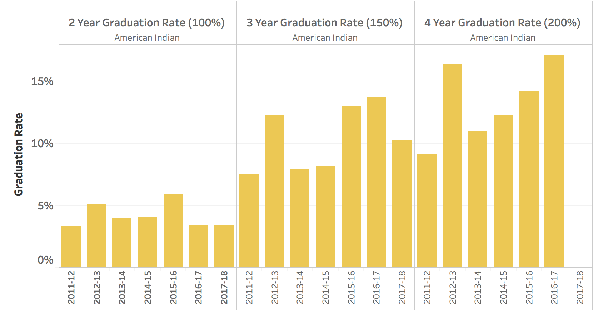
Associates Graduation Rates
Two Year holding steady for last two years
Four Year increasing steadily over the last three years.

Slide 9
Employees
2017-18 2.6%/275
2018-19 2.8%/293
2019-20 3.0%/314

Slide 10
Tribal College Partnerships
REAL TIME UPDATE on work with each of the Tribal Colleges on GEN ED Transfer and Common Course Numbering

Slide 11

Montana GEAR UP First Year Services

Slide 12
First Year Services (FYS) Overview
Pilot Partnerships with 5 campuses
Montana State University
University of Montana
Montana State University-Billings
Flathead Valley Community College
Salish Kootenai College
Pilot Partnerships with 2 campuses to support cultural supports
Montana State University
University of Montana

Slide 13
Design of First Year Services (Academic)
  Resources Committed to Provide Supports Focused on:
  Orientation
  Tutoring
  Introduction to Campus Services
  Academic Success Packages
  FAFSA Supports
  Class Registration Support
  Degree Advising
  Mentoring

Slide 14
Design of First Year Services (Cultural)
  Resources Committed to Provide Cultural Supports:
  AISS Offices on our Flagship Campuses
  Culturally Responsive Mentoring & Tutoring
  Support of Cultural Activities on Campus

Slide 15
FYS Preliminary Data (Fall 2020)
101 Students Began Fall 2020 Semester
  37% Male/64% Female
  65% American Indian
  20%+ First Generation
  45%+ Pell Eligible
  36% Took Remedial Math and/or English in First Year
  61% Finished Semester in Good Academic Standing
  91% Had at Least One Contact with FYS Mentor
  15% Withdrew at the End of the Semester

Slide 16
Future FYS Data to Include
  Percentage of students to persist to spring semester (2021)
  Percentage of students to persist to second year and beyond
  Percentage of students to persist to graduation
  Development of more robust summer bridge program and associated academic outcomes
  Increase the number of participating campuses

Slide 17
Contact Information
For more information please contact:
Angela McLean: amclean@montana.edu
Travis Anderson: tanderson@montana.edu

